Slide 1
String Handling

Slide 2
Introduction
A string is a sequence of characters.
Java implements strings as objects of type String.
String object is immutable (cannot be changed).
An immutable object is an object whose state is guaranteed to stay identical over its entire lifetime.
The difference is that each time you need an altered version of an existing string, a new String object is created that contains the modifications. The original string is left unchanged.
For those cases in which a modifiable string is desired, Java provides two options: StringBuffer and StringBuilder. Both hold strings that can be modified after they are created.

Slide 3
Using String Class
Defines a data type used to store a sequence of characters
Strings are objects
String objects can’t be modified:
If attempted to do so, Java creates a new object having the modified character sequence.
String myName = “Elliot Koffman”;
myName = “Koffman, Elliot”;
String
myName =
Value = “Elliot Koffman”
String
Value = “Elliot Koffman”

Slide 4
Using String Class
String objects can be created by two ways:
Using String literal
String s1 = “test”
Using new operator
String s1 = new String(“test”);
Using another String object
String s2 = new String(s1);
Where is a String object stored in memory location?

Slide 5
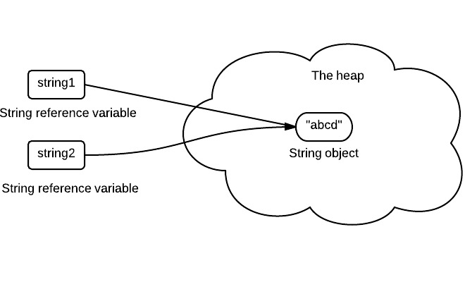
Using String Class
String pool (String intern/constant pool) is a special storage area in Java heap. When a string is created and if the string already exists in the pool, the reference of the existing string will be returned, instead of creating a new object and returning its reference to the same instance.
The following code will create only one string object in the heap.
1. String string1 = “abcd”
2. String string2 = “abcd”
Now String string2 called “abcd”.toUpperCase() which changes the same object into “ABCD”, so string1 will also be “ABCD” which is not desirable.

Slide 6
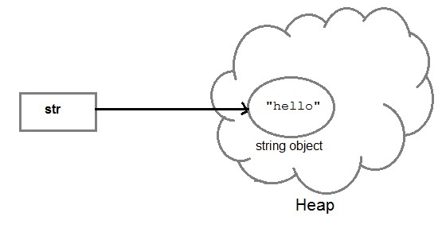
Using String Class
Each time you create a String literal, the JVM checks the string pool first. If the string literal already exists in the pool, a reference to the pool instance is returned. If string does not exist in the pool, a new string object is created, and is placed in the pool. String objects are stored in a special memory area known as string constant pool inside the heap memory.
String str= “hello";

Slide 7
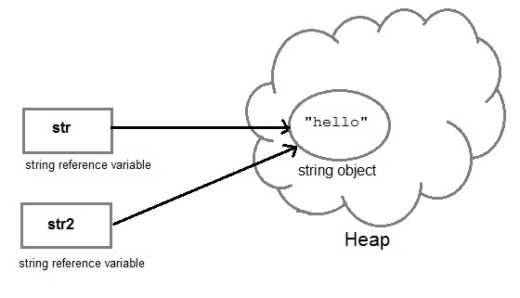
Using String Class
String str2= str;

Slide 8
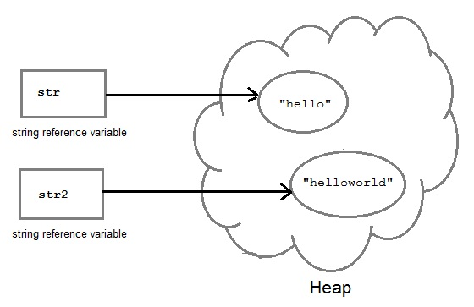
Using String Class
str2 = str2.concat(“world”);

Slide 9
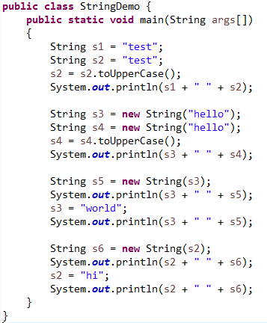
Using String Class

Slide 10
The String Constructors
The String class supports several constructors.
To create an empty String, you call the default constructor. For example,
String s = new String();
will create an instance of String with no characters in it.
To create a String initialized by an array of characters, use the constructor shown here:
String(char chars[ ])
Here is an example:
char chars[] = { 'a', 'b', 'c' };
String s = new String(chars);
This constructor initializes s with the string “abc”.

Slide 11
The String Constructors
You can specify a sub range of a character array as an initializer using the following constructor:
String(char chars[ ], int startIndex, int numChars)
Here, startIndex specifies the index at which the subrange begins, and numChars specifies the number of characters to use.
Here is an example:
char chars[] = { 'a', 'b', 'c', 'd', 'e', 'f' };
String s = new String(chars, 2, 3);
This initializes s with the characters cde.
You can construct a String object that contains the same character sequence as another String object using this constructor:
String(String strObj)

Slide 12
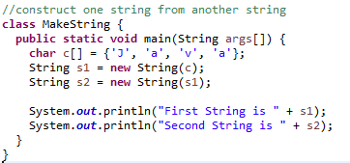

The String Constructors

Slide 13
The String Constructors
Even though Java’s char type uses 16 bits to represent the basic Unicode character set, the typical format for strings on the Internet uses arrays of 8-bit bytes constructed from the ASCII character set.
Because 8-bit ASCII strings are common, the String class provides constructors that initialize a string when given a byte array.
Their forms are shown here:
String(byte asciiChars[ ])
String(byte asciiChars[ ], int startIndex, int numChars)
Here, asciiChars specifies the array of bytes.
The second form allows you to specify a subrange. In each of these constructors, the byte-to-character conversion is done by using the default character encoding of the platform.
The program in next slide illustrates these constructors.

Slide 14
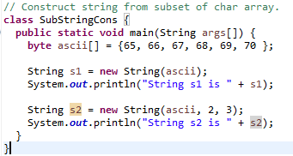

The String Constructors

Slide 15
String Length
The length of a string is the number of characters that it contains.
To obtain this value, call the length( ) method, shown here:
int length( )
The following fragment prints “3”, since there are three characters in the string s:
char chars[] = { 'a', 'b', 'c' };
String s = new String(chars);
System.out.println(s.length());

Slide 16
Special String Operations

Slide 17
String Literals
For each string literal in your program, Java automatically constructs a String object.
Thus, you can use a string literal to initialize a String object.
char chars[] = { 'a', 'b', 'c' };
String s1 = new String(chars);
String s2 = "abc"; // use string literal
Because a String object is created for every string literal, you can use a string literal any place you can use a String object.
System.out.println("abc".length());

Slide 18
String Concatenation
In general, Java does not allow operators to be applied to String objects. The one exception to this rule is the + operator, which concatenates two strings, producing a String object as the result. This allows you to chain together a series of + operations. For example, the following fragment concatenates three strings:
String age = "9";
String s = "He is " + age + " years old.";
System.out.println(s);
This displays the string “He is 9 years old.”

Slide 19
String Concatenation with Other Data Types
You can concatenate strings with other types of data. For example, consider this slightly different version of the earlier example:
int age = 9;
String s = "He is " + age + " years old.";
System.out.println(s);
The compiler will convert an operand to its string equivalent whenever the other operand of the + is an instance of String.
String s = "four: " + 2 + 2;
System.out.println(s);
This fragment displays
four: 22
rather than the
four: 4
Operator precedence causes the concatenation of “four” with the string equivalent of 2 to take place first.
String s = "four: " + (2 + 2); → Now s contains the string “four: 4”.

Slide 20
String Conversion and toString( )
When Java converts data into its string representation during concatenation, it does so by calling one of the overloaded versions of the string conversion method valueOf( ) defined by String. valueOf( ) is overloaded for all the simple types and for type Object.
For the simple types, valueOf( ) returns a string that contains the human-readable equivalent of the value with which it is called.
For objects, valueOf( ) calls the toString( ) method on the object.
The toString( ) method, because it is the means by which you can determine the string representation for objects of classes that you create.
The toString( ) method has this general form:
String toString( )

Slide 21
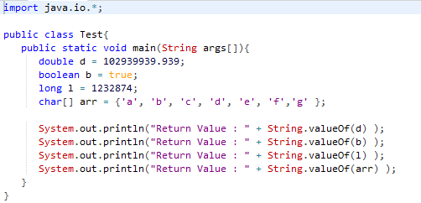

Data conversion using valueOf( )

Slide 22
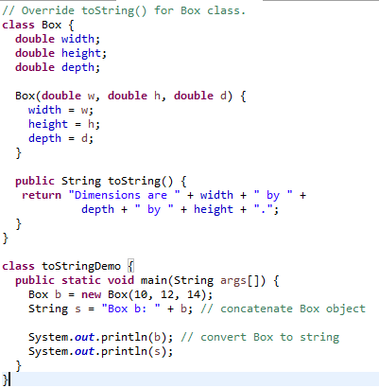

String Conversion and toString( )

Slide 23
Character Extraction

Slide 24
charAt( )
To extract a single character from a String, you can refer directly to an individual character via the charAt( ) method. It has this general form:
char charAt(int where)
Here, where is the index of the character that you want to obtain.
The value of where must be nonnegative and specify a location within the string. charAt( ) returns the character at the specified location.
For example,
char ch;
ch = "abc".charAt(1);
assigns the value “b” to ch.

Slide 25
getChars( )
If you need to extract more than one character at a time, you can use the getChars( ) method.
It has this general form:
public void getChars(int srcBegin, int srcEnd, char[] dst, int dstBegin)
srcBegin -- index of the first character in the string to copy.
srcEnd -- index after the last character in the string to copy.
dst -- the destination array.
dstBegin -- the start offset in the destination array.
It does not return any value but throws IndexOutOfBoundsException.

Slide 26
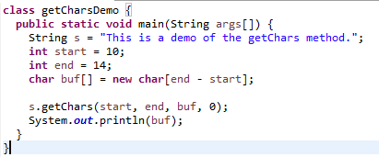
getChars( )

Slide 27
getBytes( )
There is an alternative to getChars( ) that stores the characters in an array of bytes. This method is called getBytes( ), and it uses the default character-to-byte conversions provided by the platform.
Here is its simplest form:
byte[ ] getBytes( )
Other forms of getBytes( ) are also available. getBytes( ) is most useful when you are exporting a String value into an environment that does not support 16-bit Unicode characters. For example, most Internet protocols and text file formats use 8-bit ASCII for all text interchange.

Slide 28
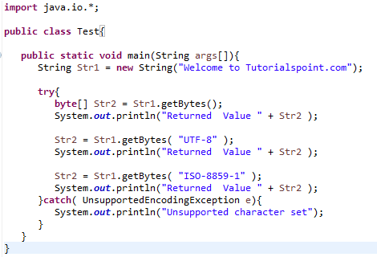

getBytes( )

Slide 29
toCharArray()
If you want to convert all the characters in a String object into a character array, the easiest way is to call toCharArray( ). It returns an array of characters for the entire string. It has this general form:
char[ ] toCharArray( )
It returns a newly allocated character array, whose length is the length of this string and whose contents are initialized to contain the character sequence represented by this string.
This function is provided as a convenience, since it is possible to use getChars( ) to achieve the same result.

Slide 30
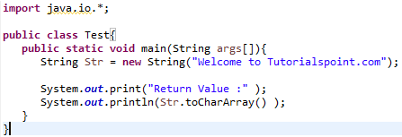
toCharArray()

Slide 31
String Comparison

Slide 32
equals( ) and equalsIgnoreCase( )
To compare two strings for equality, use equals( ). It has this general form:
boolean equals(Object str)
Here, str is the String object being compared with the invoking String object. It returns true if the strings contain the same characters in the same order, and false otherwise. The comparison is case-sensitive.
To perform a comparison that ignores case differences, call equalsIgnoreCase( ). When it compares two strings, it considers A-Z to be the same as a-z. It has this general form:
boolean equalsIgnoreCase(String str)
Here, str is the String object being compared with the invoking String object. It, too, returns true if the strings contain the same characters in the same order, and false otherwise.

Slide 33
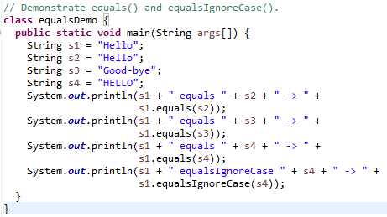

equals( ) and equalsIgnoreCase( )

Slide 34
regionMatches( )
The regionMatches( ) method compares a specific region inside a string with another specific region in another string.
Here are the general forms for these two methods:
boolean regionMatches(int startIndex, String str2,
int str2StartIndex, int numChars)
boolean regionMatches(boolean ignoreCase, int startIndex, String str2,
int str2StartIndex, int numChars)
For both versions, startIndex specifies the index at which the region begins within the invoking String object.
The String being compared is specified by str2.
The index at which the comparison will start within str2 is specified by str2StartIndex.
The length of the substring being compared is passed in numChars.
In the second version, if ignoreCase is true, the case of the characters is ignored. Otherwise, case is significant.

Slide 35
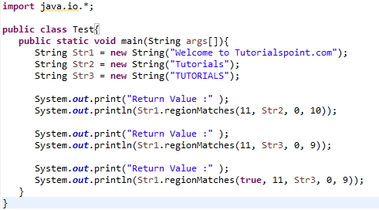
regionMatches( )

Slide 36
startsWith( ) and endsWith( )
The startsWith( ) method determines whether a given String begins with a specified string.
Conversely, endsWith( ) determines whether the String in question ends with a specified string.
They have the following general forms:
boolean startsWith(String str)
boolean endsWith(String str)
Here, str is the String being tested. If the string matches, true is returned. Otherwise, false is returned.
For example,
"Foobar".endsWith("bar")
and
"Foobar".startsWith("Foo")
are both true.

Slide 37
startsWith( ) and endsWith( )
A second form of startsWith( ), shown here, lets you specify a starting point:
boolean startsWith(String str, int startIndex)
Here, startIndex specifies the index into the invoking string at which point the search will begin.
For example,
"Foobar".startsWith("bar", 3)
returns true.

Slide 38
Equals vs. ==
It is important to understand that the equals( ) method and the == operator perform two different operations.
As just explained, the equals( ) method compares the characters inside a String object.
The == operator compares two object references to see whether they refer to the same instance.
The following program shows how two different String objects can contain the same characters, but references to these objects will not compare as equal:

Slide 39
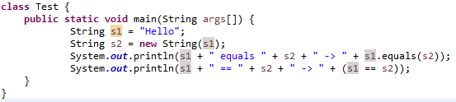

equals vs. ==

Slide 40
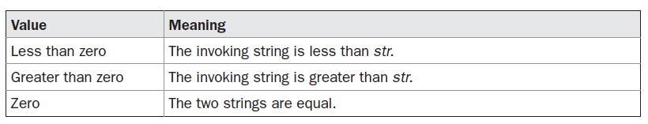
compareTo()
Often, it is not enough to simply know whether two strings are identical. For sorting applications, you need to know which is less than, equal to, or greater than the next. A string is less than another if it comes before the other in dictionary order.
A string is greater than another if it comes after the other in dictionary order.
The String method compareTo( ) serves this purpose. It has this general form:
int compareTo(String str)
Here, str is the String being compared with the invoking String. The result of the comparison is returned and is interpreted, as shown here:

Slide 41
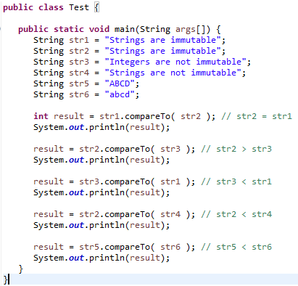
compareTo()

Slide 42
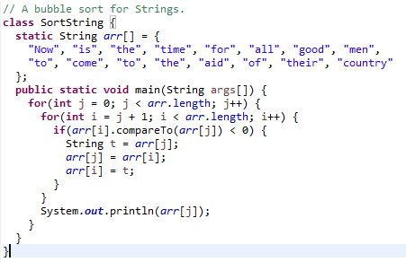

compareTo()

Slide 43
Searching Strings

Slide 44
Searching Strings
The String class provides two methods that allow you to search a string for a specified character or substring:
indexOf( ) Searches for the first occurrence of a character or substring.
lastIndexOf( ) Searches for the last occurrence of a character or substring.
These two methods are overloaded in several different ways. In all cases, the methods return the index at which the character or substring was found, or –1 on failure.

Slide 45
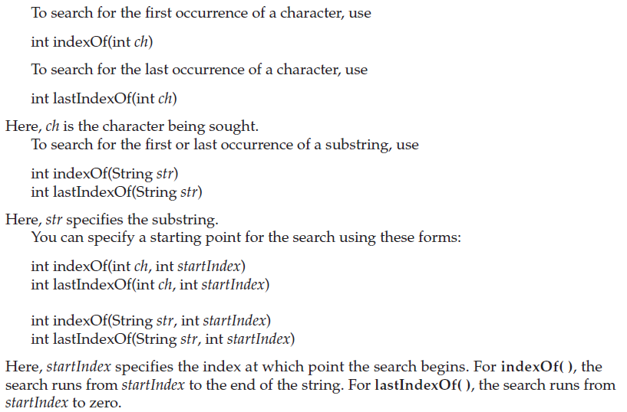
Searching Strings

Slide 46
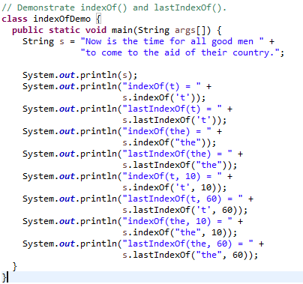
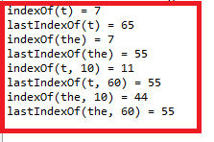
Searching Strings

Slide 47
substring()
You can extract a substring using substring( ).
It has two forms. The first is
String substring(int startIndex)
Here, startIndex specifies the index at which the substring will begin.
This form returns a copy of the substring that begins at startIndex and runs to the end of the invoking string.
The second form of substring( ) allows you to specify both the beginning and ending index of the substring:
String substring(int startIndex, int endIndex)
Here, startIndex specifies the beginning index, and endIndex specifies the stopping point.
The string returned contains all the characters from the beginning index, up to, but not including, the ending index.

Slide 48
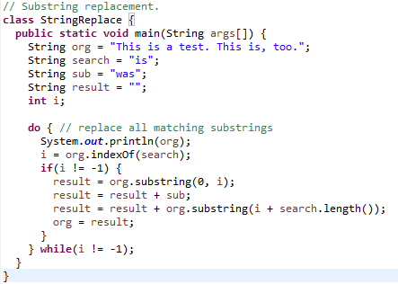
substring()

Slide 49
concat()
You can concatenate two strings using concat( ), shown here:
String concat(String str)
This method creates a new object that contains the invoking string with the contents of str appended to the end. concat( ) performs the same function as +.
For example,
String s1 = "one";
String s2 = s1.concat("two");
puts the string “onetwo” into s2. It generates the same result as the following sequence:
String s1 = "one";
String s2 = s1 + "two";

Slide 50
replace()
The replace( ) method has two forms.
The first replaces all occurrences of one character in the invoking string with another character. It has the following general form:
String replace(char original, char replacement)
Here, original specifies the character to be replaced by the character specified by replacement.
The resulting string is returned. For example,
String s = "Hello".replace('l', 'w');
puts the string “Hewwo” into s.
The second form of replace( ) replaces one character sequence with another. It has this general form:
String replace(CharSequence original, CharSequence replacement)
public String replaceAll(String regex, String replacement)
public String replaceFirst(String regex, String replacement)

Slide 51
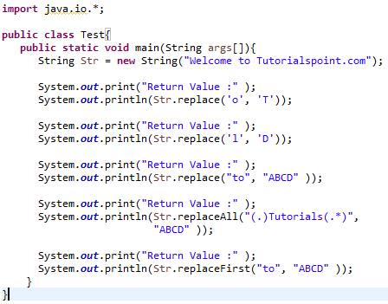

replace()

Slide 52
trim()
The trim() method returns a copy of the invoking string from which any leading and trailing whitespace has been removed.
It has this general form:
String trim( )
Here is an example:
String s = " Hello World ".trim();
This puts the string “Hello World” into s.
The trim() method is quite useful when you process user commands.
For example, the following program prompts the user for the name of a state and then displays that state’s capital.
It uses trim() to remove any leading or trailing whitespace that may have inadvertently been entered by the user.

Slide 53
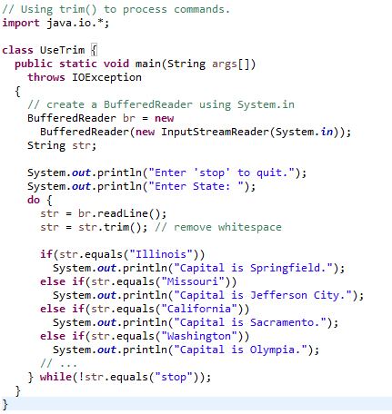
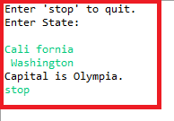
trim()

Slide 54
Changing the Case of Characters Within a String

Slide 55
Changing the Case of Characters Within a String
The method toLowerCase( ) converts all the characters in a string from uppercase to lowercase.
The toUpperCase( ) method converts all the characters in a string from lowercase to uppercase.
Nonalphabetical characters, such as digits, are unaffected.
Here are the general forms of these methods:
String toLowerCase( )
String toUpperCase( )
Both methods return a String object that contains the uppercase or lowercase equivalent of the invoking String.

Slide 56
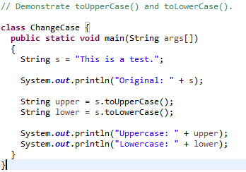

Changing the Case of Characters Within a String

Slide 57
StringBuffer

Slide 58
StringBuffer
As you know, String represents fixed-length, immutable character sequences.
In contrast, StringBuffer represents growable and writeable character sequences.
StringBuffer may have characters and substrings inserted in the middle or appended to the end.
StringBuffer will automatically grow to make room for such additions and often has more characters preallocated than are actually needed, to allow room for growth.
Java uses both classes heavily, but many programmers deal only with String and let Java manipulate StringBuffers behind the scenes by using the overloaded + operator.

Slide 59
StringBuffer Constructors
StringBuffer defines these four constructors:
StringBuffer( )
StringBuffer(int size)
StringBuffer(String str)
StringBuffer(CharSequence chars)
The default constructor (the one with no parameters) reserves room for 16 characters without reallocation.
The second version accepts an integer argument that explicitly sets the size of the buffer.
The third version accepts a String argument that sets the initial contents of the StringBuffer object and reserves room for 16 more characters without reallocation.

Slide 60
StringBuffer Constructors
StringBuffer allocates room for 16 additional characters when no specific buffer length is requested, because reallocation is a costly process in terms of time.
Also, frequent reallocations can fragment memory.
By allocating room for a few extra characters, StringBuffer reduces the number of reallocations that take place.
The fourth constructor creates an object that contains the character sequence contained in chars.

Slide 61
String and StringBuffer
String | StringBuffer
String class is immutable. | StringBuffer class is mutable.
String is slow and consumes more memory when you concat too many strings because every time it creates new instance. | StringBuffer is fast and consumes less memory when you concat strings.
String class overrides the equals() method of Object class. So you can compare the contents of two strings by equals() method. | StringBuffer class doesn't override the equals() method of Object class.

Slide 62
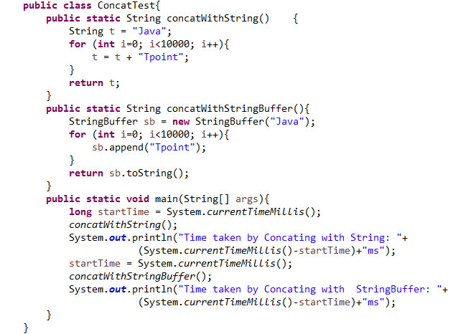
Performance Test of String and StringBuffer

Slide 63
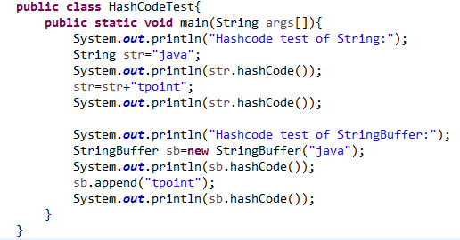
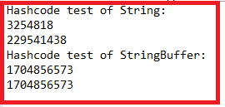
HashCode Test of String and StringBuffer

Slide 64
length() and capacity()
The current length of a StringBuffer can be found via the length( ) method, while the total allocated capacity can be found through the capacity( ) method.
They have the following general forms:
int length( )
int capacity( )
Here is an example next slide:

Slide 65
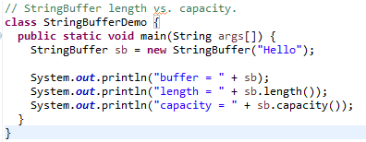

length( ) and capacity( )

Slide 66
ensureCapacity()
If you want to preallocate room for a certain number of characters after a StringBuffer has been constructed, you can use ensureCapacity( ) to set the size of the buffer.
This is useful if you know in advance that you will be appending a large number of small strings to a StringBuffer.
ensureCapacity( ) has this general form:
void ensureCapacity(int capacity)
Here, capacity specifies the size of the buffer.

Slide 67
setLength()
To set the length of the buffer within a StringBuffer object, use setLength( ).
Its general form is shown here:
void setLength(int len)
Here, len specifies the length of the buffer. This value must be nonnegative.
When you increase the size of the buffer, null characters are added to the end of the existing buffer.
If you call setLength( ) with a value less than the current value returned by length( ), then the characters stored beyond the new length will be lost.
The setCharAtDemo sample program in the following section uses setLength( ) to shorten a StringBuffer.

Slide 68
charAt() and setCharAt()
The value of a single character can be obtained from a StringBuffer via the charAt( ) method.
You can set the value of a character within a StringBuffer using setCharAt( ).
Their general forms are shown here:
char charAt(int where)
void setCharAt(int where, char ch)
For charAt( ), where specifies the index of the character being obtained.
For setCharAt( ), where specifies the index of the character being set, and ch specifies the new value of that character.
For both methods, where must be nonnegative and must not specify a location beyond the end of the buffer.

Slide 69
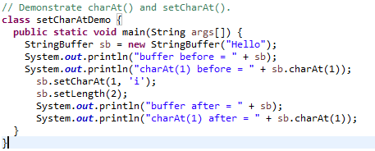

charAt() and setCharAt()

Slide 70
getChars()
To copy a substring of a StringBuffer into an array, use the getChars( ) method.
It has this general form:
void getChars(int sourceStart, int sourceEnd, char target[ ], int targetStart)
Here, sourceStart specifies the index of the beginning of the substring, and sourceEnd specifies an index that is one past the end of the desired substring.
This means that the substring contains the characters from sourceStart through sourceEnd–1. The array that will receive the characters is specified by target. The index within target at which the substring will be copied is passed in targetStart.
Care must be taken to assure that the target array is large enough to hold the number of characters in the specified substring.

Slide 71
append()
The append( ) method concatenates the string representation of any other type of data to the end of the invoking StringBuffer object. It has several overloaded versions.
Here are a few of its forms:
StringBuffer append(String str)
StringBuffer append(int num)
StringBuffer append(Object obj)
String.valueOf( ) is called for each parameter to obtain its string representation.
The result is appended to the current StringBuffer object. The buffer itself is returned by each version of append( ).

Slide 72
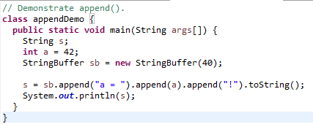
append()

Slide 73
append()
The append( ) method is most often called when the + operator is used on String objects.
Java automatically changes modifications to a String instance into similar operations on a StringBuffer instance.
Thus, a concatenation invokes append( ) on a StringBuffer object.
After the concatenation has been performed, the compiler inserts a call to toString( ) to turn the modifiable StringBuffer back into a constant String.
All of this may seem unreasonably complicated.
Why not just have one string class and have it behave more or less like StringBuffer?
The answer is performance. There are many optimizations that the Java run time can make knowing that String objects are immutable.
Thankfully, Java hides most of the complexity of conversion between Strings and StringBuffers.
Actually, many programmers will never feel the need to use StringBuffer directly and will be able to express most operations in terms of the + operator on String variables.

Slide 74
insert()
The insert( ) method inserts one string into another. It is overloaded to accept values of all the simple types, plus Strings, Objects, and CharSequences.
Like append( ), it calls String.valueOf( ) to obtain the string representation of the value it is called with.
This string is then inserted into the invoking StringBuffer object.
These are a few of its forms:
StringBuffer insert(int index, String str)
StringBuffer insert(int index, char ch)
StringBuffer insert(int index, Object obj)
Here, index specifies the index at which point the string will be inserted into the invoking StringBuffer object.

Slide 75
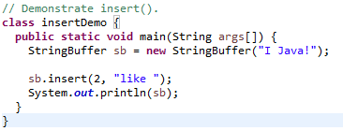
insert()

Slide 76
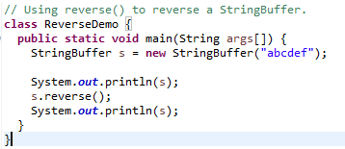
reverse()
You can reverse the characters within a StringBuffer object using reverse( ), shown here:
StringBuffer reverse( )
This method returns the reversed object on which it was called.

Slide 77
delete() and deleteCharAt()
You can delete characters within a StringBuffer by using the methods delete( ) and deleteCharAt( ).
These methods are shown here:
StringBuffer delete(int startIndex, int endIndex)
StringBuffer deleteCharAt(int loc)
The delete( ) method deletes a sequence of characters from the invoking object.
Here, startIndex specifies the index of the first character to remove, and endIndex specifies an index one past the last character to remove.
Thus, the substring deleted runs from startIndex to endIndex–1.
The resulting StringBuffer object is returned.
The deleteCharAt( ) method deletes the character at the index specified by loc. It returns the resulting StringBuffer object.

Slide 78
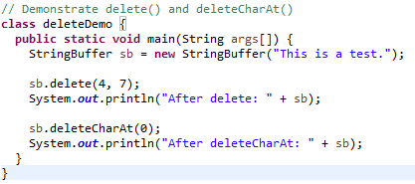

delete() and deleteCharAt()

Slide 79
replace()
You can replace one set of characters with another set inside a StringBuffer object by calling replace( ).
Its signature is shown here:
StringBuffer replace(int startIndex, int endIndex, String str)
The substring being replaced is specified by the indexes startIndex and endIndex. Thus, the substring at startIndex through endIndex–1 is replaced.
The replacement string is passed in str.
The resulting StringBuffer object is returned.

Slide 80
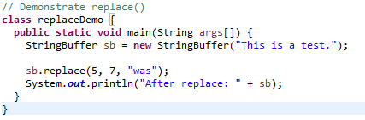

replace()

Slide 81
THANK YOU!!
ANY QUESTIONS??

